Slide 1
Cancer Module
The Cancer Module has 5 units. Each unit lasts about a week and covers one of the critical questions we will need to answer if we want to understand cancer.
Unit 1: What is cancer and why should we care?
Unit 2: What does it mean to be a ‘normal’ cell?
Unit 3: How does a normal cell become cancerous?
Unit 4: How does cancer make us sick?
Unit 5: How is cancer treated?
Notes:
1- Understanding what cancer is, and the factors that predispose us towards developing it.
2 And 3- Go in depth into how cancer develops at the cellular level.
4- Will look at the biology of cancer from the lens of the entire body.
5- Will examine how cancer is diagnosed and treated.

Slide 2
Cancer
Lesson 1.1
Why should we care about cancer?

Slide 3
Do Now
Is cancer an old-person’s disease?
Does the size of a tumor decide how dangerous it is?

Slide 4
Activity: Define the terms tumor, malignant, and benign.
Tumor: A mass of tissue that is caused by the abnormal growth of cells. A tumor can be benign or malignant.
Benign Tumor: A mass of abnormal cells that is confined to one place in the body.
Malignant Tumor (Cancer): A mass of abnormal cells that can invade surrounding tissue and eventually spread throughout the body, causing life-threatening disease.

Slide 5
Activity: Why did Steve Jobs die?
Notes:
How could such a smart man do such a stupid thing?

Slide 6
Activity: How did Steve Jobs die?
2003 – Jobs was diagnosed with a neuroendocrine tumor of the pancreas. (48)
2004 – Jobs had pancreatic surgery to remove the primary tumor. (49)
2009 – Jobs had a liver transplant to remove secondary tumors in the liver. (54)
2011 – Jobs died of respiratory arrest related to tumors in his lung. (56)

Slide 7
Activity:
‘How could such a smart man do such a stupid thing?’
Notes:
Steve received a lot of criticism for the decision not to have surgery earlier and died thinking he had been irresponsible by not having his pancreatic surgery 9 months earlier. But did the delay impact the outcome of his disease? Students calculate when Steve’s tumor actually appeared and when it spread to his liver, and then deduce whether the delay would have made a difference.

Slide 8
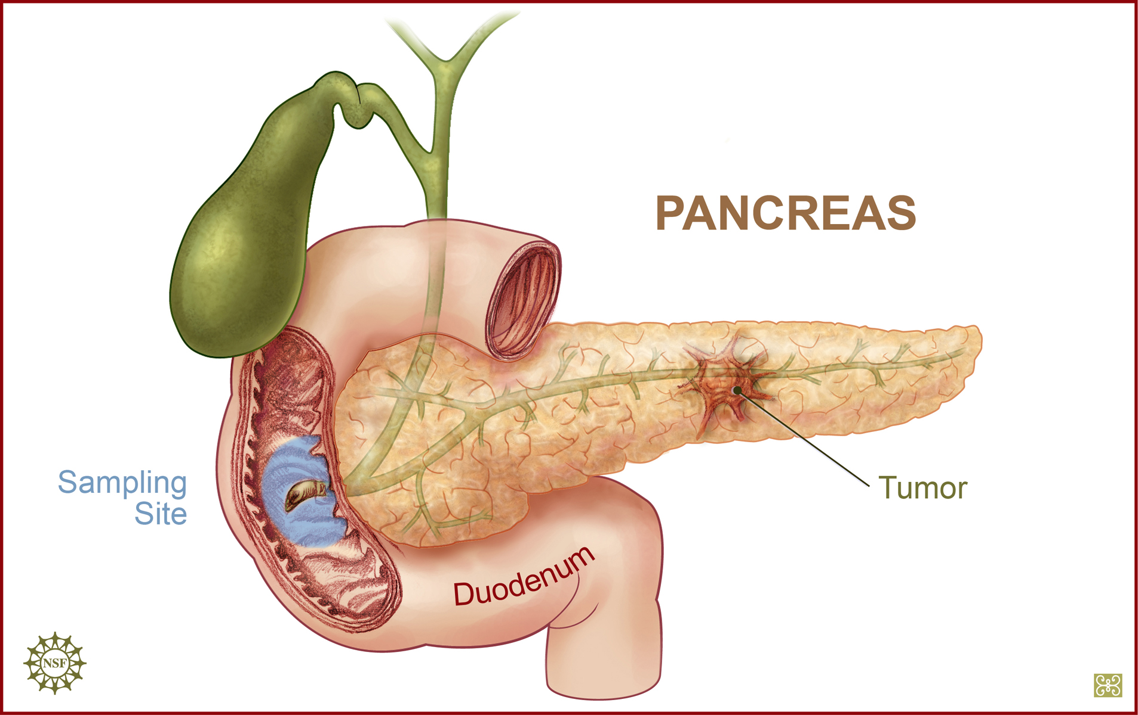
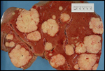
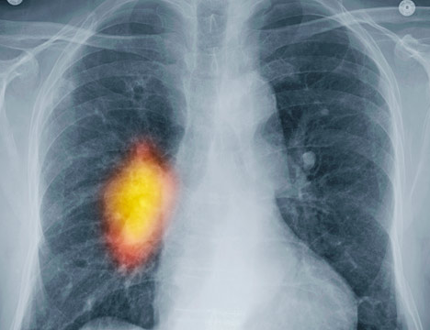
Calculate the tumor doubling rate:
1 cell
Pancreas – 10 mm
Liver - 100 mm
Lung – 100 mm
1 cell
Age 48
Transplant age 54
Death age 56
Notes:
What will determine when a tumor appears?
The rate at which the cell divides and the rate at which the cells die. Normally the ratio is 1:1. In tumor cells the rate of proliferation exceeds the rate of death.
10 mm = SEEN by CAT scan
100 mm= IMPACTS ORGAN FX

Slide 9
When did the first tumor begin to form in the pancreas?
48 years old
?
1 cell
1 billion cells (1 x 10⁹ cells)
Primary tumor cells double every 10 months
How many doublings to get to 1 billion cells?
Notes:
Source: http://www.drmcdougall.com/misc/2011nl/nov/jobs.htm

Slide 10
Doubling table
# of Doublings | # of Cells | # of Doublings | # of Cells | # of Doublings | # of Cells | # of Doublings | # of Cells
1 | 2 | 11 | 2,048 | 21 | 2,097,152 | 31 | 2.1 x 10⁹
2 | 4 | 12 | 4,096 | 22 | 4,194,304 | 32 | 4.2 x 10⁹
3 | 8 | 13 | 8,192 | 23 | 8,388,608 | 33 | 8.6 x 10⁹
4 | 16 | 14 | 16,384 | 24 | 1.7 x 10⁷ | 34 | 1.7 x 10¹⁰
5 | 32 | 15 | 32,768 | 25 | 3.4 x 10⁷ | 35 | 3.4 x 10¹⁰
6 | 64 | 16 | 65,536 | 26 | 6.7 x 10⁷ | 36 | 6.9 x 10¹⁰
7 | 128 | 17 | 131,072 | 27 | 1 x 10⁸ | 37 | 1.4 x 10¹¹
8 | 256 | 18 | 262,144 | 28 | 2.6 x 10⁸ | 38 | 2.7 x 10¹¹
9 | 512 | 19 | 524,288 | 29 | 5.4 x 10⁸ | 39 | 5.5 x 10¹¹
10 | 1,024 | 20 | 1,048,576 | 30 | 1.1 x 10⁹ | 40 | 1.1 x 10¹²

Slide 11
When did the first tumor begin to form?
48 years old
?
1 cell
1 billion cells
Primary tumor doubles every 10 months
Takes 30 doublings to reach 1 billion cells
30 * 10 = 300 months = 25 years to form
Steve Jobs first cancer cell formed when he was 48 - 25 = 23 years old!
Notes:
http://www.drmcdougall.com/misc/2011nl/nov/jobs.htm
SOLID TUMORS IN ORGANS usually double in size every 3- 9 months

Slide 12
Steve Jobs had surgery to remove his pancreas in July 2004
Nine months after it was detected
Tumors (white) in liver (red)
During the operation they noticed that there were tumors in the liver.
This was due to the spread of pancreatic cancer cells to the liver.
How did it spread?

Slide 13
Cancer spreads from its primary site through the bloodstream
This is called metastasis.

Slide 14
When did it spread to the liver?
Metastatic cancer cells double more rapidly than primary tumors cells
– every 8 months
Detected at age 49 years
Liver transplant (age 54)
1 cell
1 billion cells
Metastatic tumor doubles every 8 months
Takes 30 doublings to reach 1 billion cells
30 * 8 = 240 months = 20 years to form
Steve Jobs’ tumor metastasized to his liver when he was 49 - 20 = 29 years old!

Slide 15
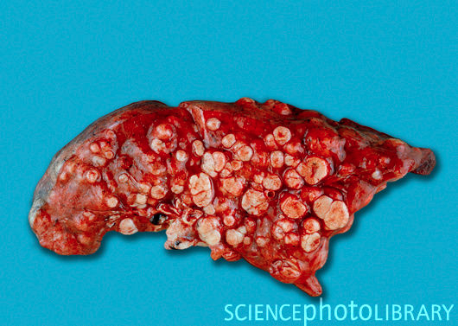
Steve Jobs finally died of respiratory failure when he was 56
Affects lung function (age 56)
1 cell
1 trillion cells
(1 x 10¹² cells)
Metastatic tumor doubles every 8 months
Takes 40 doublings to reach 1 trillion cells
40 * 8 = 320 months = 26.6 years to form
Steve Jobs’ tumor metastasized to his lung when he was 56 – 26.6 = 29.4 years old!

Slide 16
Wrap Up
Did Steve Jobs make a bad decision by delaying his treatment
for 9 months?

Slide 17
Steve Jobs had surgery and treatment for his cancers in his late 40s/early 50s.
These tumors likely formed when he was in his 20s, when he was building computers in his garage.
Electronics (such as computers) contain heavy metals such as cadmium and lead – agents known to cause cancer.

Slide 18
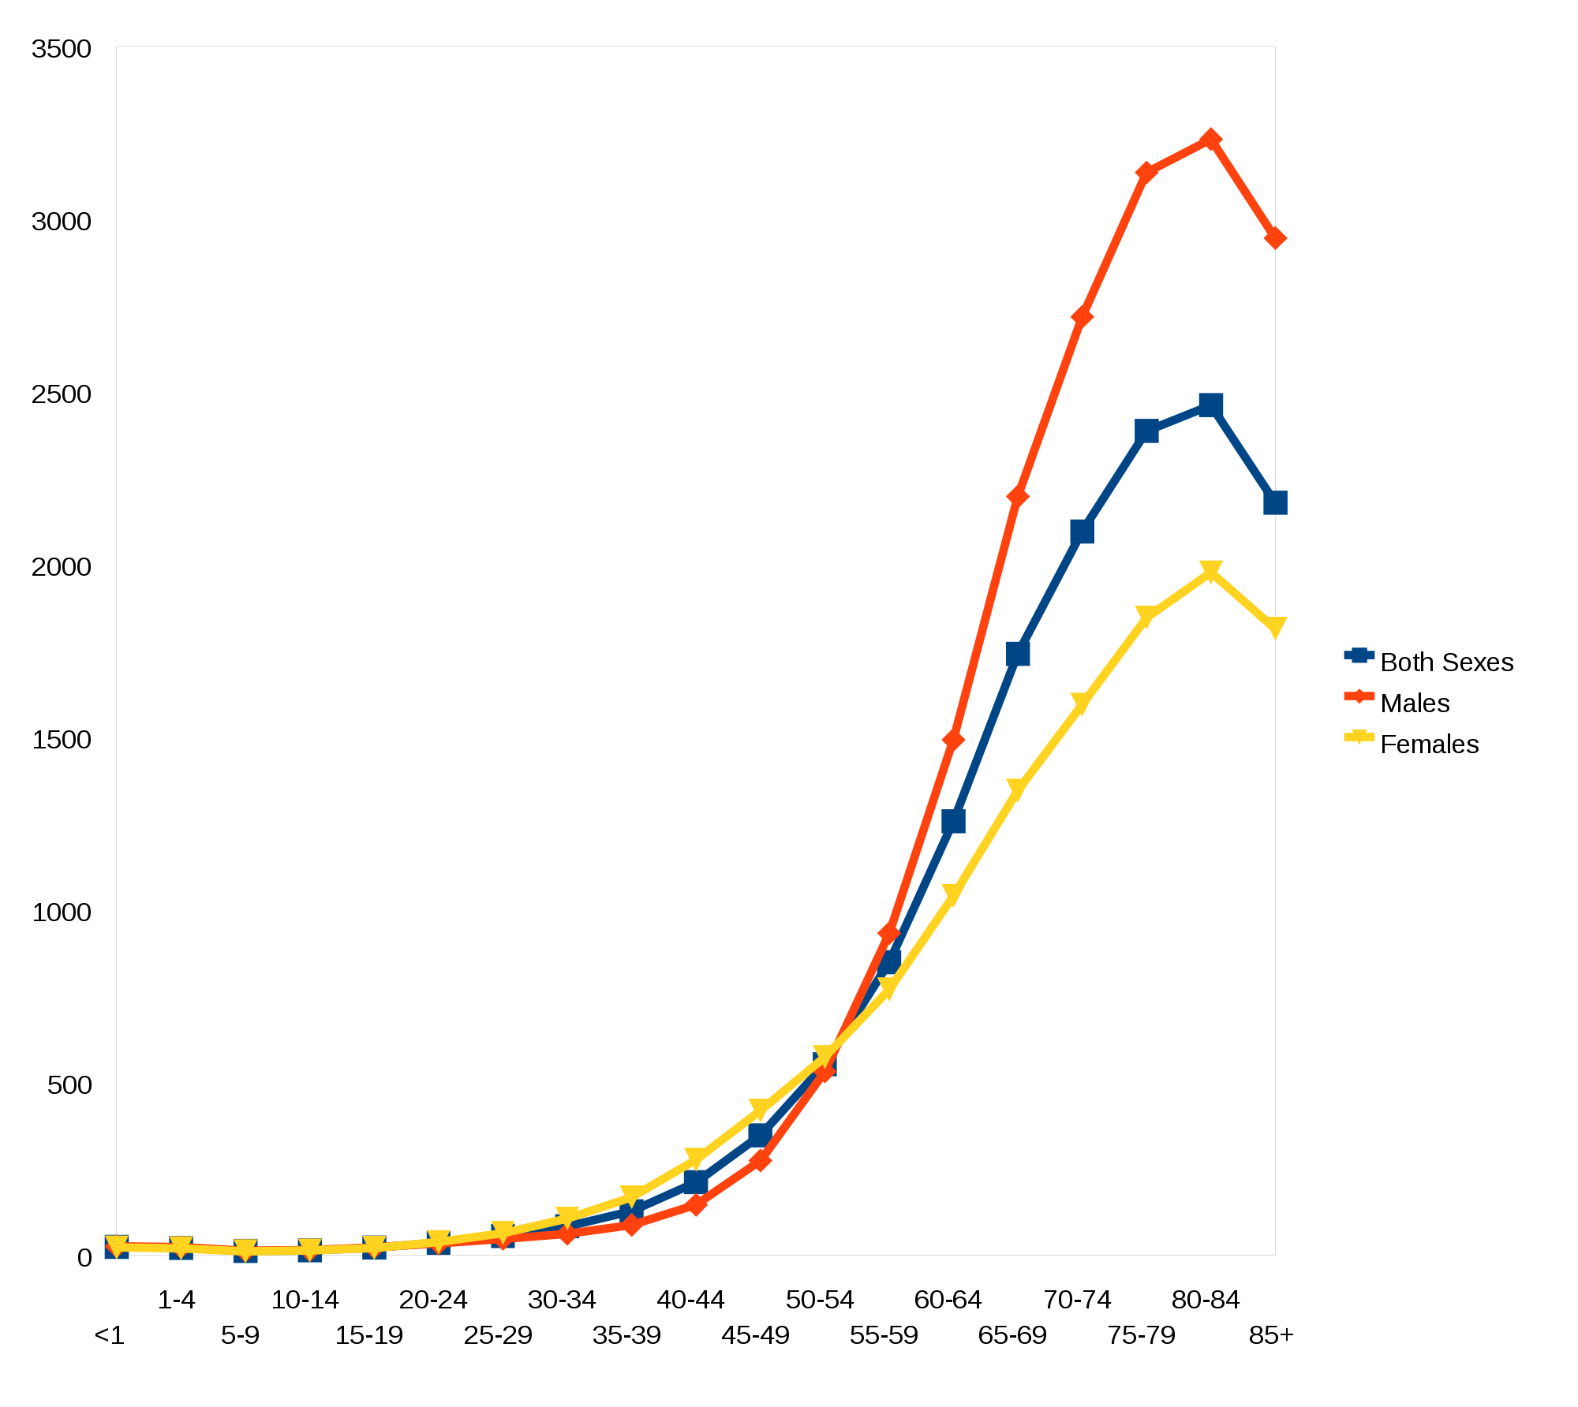
Cancer is mostly a disease of age –or is it?
Deaths from cancer/100,000
NCI 2003 -2007

Slide 19
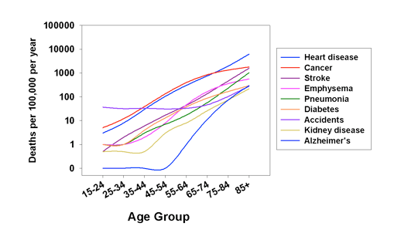
Cancer is also a leading cause of death in adolescents & young adults
Notes:
This represents deaths due to cancer. People diagnosed with cancer, if treated early, can survive.

Slide 20
Homework:
What behaviors/choices do I (or my friends) make that may predispose me (them) to developing cancer at an earlier age?

